Slide 1
What does each of these mean?
Brand Mentions -------------------------
Number of times your brand appeared in AI answers out of total tracked prompts
Share of Voice -------------------------
Percentage of your band mentions compared to all total brand mentions
Brand Position -------------------------
Average position of your brand in AI answers
Goals
Domain Citation -------------------------
Number of times your website was cited on AI Search Engines
Brand Coverage -------------------------
Percentage of prompts that mention your brand
Domain Coverage -------------------------
Percentage of prompts that cited your website
Source: Otterly.ai

Slide 2
The Approach For Solving GEO
Citability Can LLMs trust your content?
We rewrite content to include expert quotes, references, structured data
We improve source credibility through media presence, high-authority citations, and entity recognition
We restructure pages to be chunkable and retrievable
Visibility Can LLMs see your content?
We audit if you’re being cited across AI Search (ChatGPT, Perplexity, SGE)
We identify which competitors are winning those spots - and why
We check if your URLs are indexable, link-worthy, and retrievable
Pepper’s GEO Approach
Retrievability: Can LLMs use your content to answer future questions?
We chunk and tag your content to feed RAG systems better
We add LLM-readable markup and context layering (FAQs, comparisons, summaries)
We monitor which prompts lead to brand visibility and close the loop
MAY 2024

Slide 3
Reverse Engineering How LLMs Index Content
∝
(Chunking × Structure × Schema × Source Weight × Trust Signals)
LLM Retrieval Score
Variable | What It Means | How Pepper Optimizes It
Chunking | Atomic 2–4 sentence blocks ideal for embedding + summarization | We rewrite long-form into discrete semantic units
Structure | Use of TL;DRs, bullets, lists, Q&A formatting | Content is formatted with high semantic clarity
Schema | Machine-readable metadata (FAQPage, HowTo, Product) | Implemented across product pages, glossaries, and help docs
Source Weight | LLM preference hierarchy (Wikipedia > PDF > Help Docs > Blogs > Social) | Content is distributed into high-weight surfaces LLMs trust
Trust Signals | Presence of citations, statistics, interlinking, and cross-source agreement | We embed outbound and inbound credibility into every content artifact

Slide 4
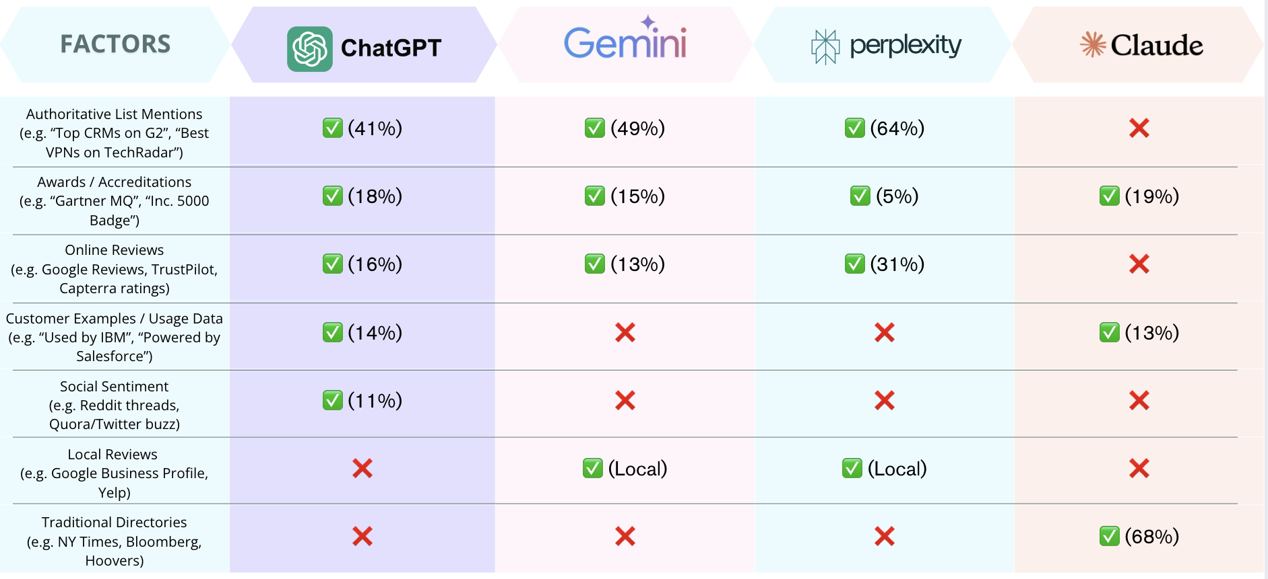
The Content Strategy : Source Weightages by LLMs

Slide 5
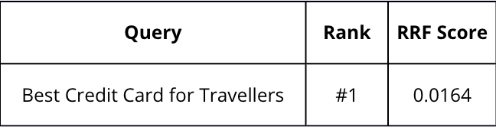
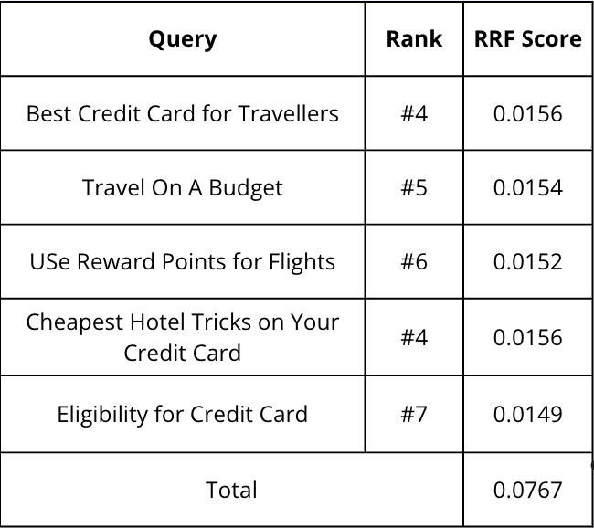





The Content Strategy : Topical Authority
Brand A
Brand B
∝
LLM Recommendations
RRF Score = Σ [1 / (60 + SERP position)]
Illustration
Building Topical Authority still tops the content priority, with the relevant technical optimisation for each URL
The key reason of smaller publishers/brands doing well on LLM queries is their trust-signalling coverage

Slide 6





Strategy to Dominate Generative Search (GEO)
Goals
1.
Curate Prompt List
Curate a list of relevant prompts
2.
Multi LLM Analysis
Analyze the responses from different LLMs
3.
Citation & Brand Mention Audit
Review of cited URLs & brand mentions
4.
Page Creation & Optimization
Identifying pages to be created & optimized
5.
Community Visibility
Access your presence of reddit, Quora forums
6. Implement & Iterate – Create new pages, update existing pages, implement schemas, and community replies and re-run the prompt set monthly to gauge lift and uncover new topical gaps.

Slide 7
Here, is the customised content strategy table for you!
Source Type | Estimated Weight | Notes | % Weightage (Approx.) | Relevant Examples
Product & Platform Pages | Very High | Core retrieval: prompts like “ServiceNow ITSM,” “ServiceNow workflow automation,” “Now Platform AI.” | 25% | ITSM, ITOM, CSM, HRSD, Creator Workflows, Now Assist (GenAI)
Industry Solutions Pages | High | For prompts like “ServiceNow for banking,” “workflow automation for healthcare,” “government digital services.” | 14% | Financial services, healthcare, manufacturing, government, telecom
AI & Technology Innovation Pages | High | For prompts like “ServiceNow AI,” “Now Assist generative AI,” “ServiceNow platform intelligence.” | 13% | GenAI copilots, predictive intelligence, ServiceNow Vancouver/Washington releases
Customer Stories / Case Studies | High | Retrieval for “who uses ServiceNow,” “ServiceNow ROI,” “ServiceNow success stories.” | 12% | Case studies with Citi, DHL, Novartis, government agencies
Pricing / Demo Pages | Medium-High | For prompts like “ServiceNow demo,” “ServiceNow pricing,” “ServiceNow enterprise license.” | 10% | Request a demo, Now Assist ROI tools
Documentation & Knowledge Base | Medium | Retrieval for prompts like “ServiceNow API,” “ServiceNow developer docs,” “ServiceNow workflow integration.” | 8% | Developer portal, integration hub docs, API references
Events & Webinars (Knowledge) | Medium | For prompts like “ServiceNow Knowledge conference,” “ServiceNow webinars,” “future of IT workflows.” | 6% | Knowledge conference sessions, leadership keynotes
Press & Newsroom | Medium-Low | For prompts like “ServiceNow earnings,” “ServiceNow acquisitions,” “ServiceNow expansion.” | 6% | Acquisitions (Element AI, Era Software, Hitch Works), quarterly earnings
Support / Help Center | Low-Medium | For prompts like “ServiceNow login,” “ServiceNow ticket help,” “support portal.” | 4% | Support portal, instance upgrades, troubleshooting
Careers & Corporate Pages | Low | For prompts like “jobs at ServiceNow,” “ServiceNow culture,” “ServiceNow DEI.” | 2% | Careers site, employee stories, ESG reports
Note: The weightage percentage is a relative effort guide.
If you're putting X effort on a source with 2% weight, then a source with 8% weight deserves 4X effort. Prioritize accordingly to match impact with visibility potential.
MAY 2024

Slide 8
Do you think this was helpful and want to dive deeper?
Reach us at +14157545133 or write to us at kishan@peppercontent.io
We are hosting some free GEO workshops for corporates and if you think you’d be interested in the same, please write to us
MAY 2024

